Slide 1
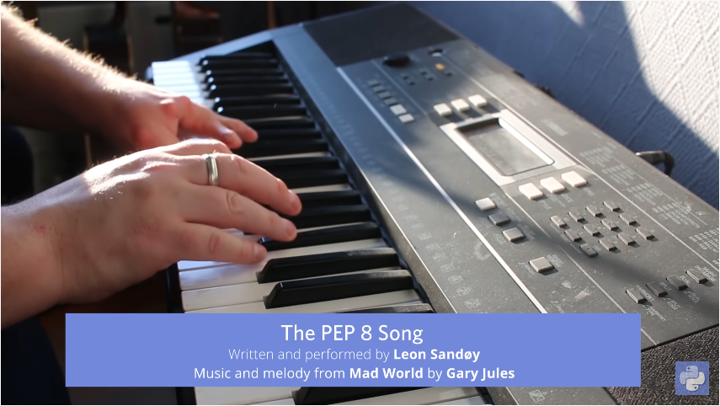
https://www.youtube.com/watch?v=hgI0p1zf31k

Slide 2


PYTHON BÁSICO – INTRO
Prof. Manoel Gadi
mfalonso@faculty.ie.edu

Slide 3
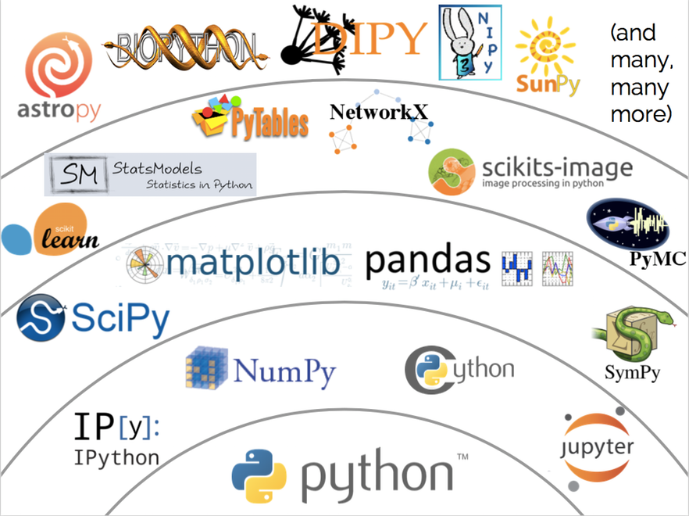

Slide 4

Play Introduction (up to 0:30 and minute 3:00).
https://talkpython.fm/episodes/show/100/python-past-present-and-future-with-guido-van-rossum

Slide 5
In Guido's first university year - what were the only two languages thought?
A) Python & Java
B) C++ & VBA
C) Algo & Pascal
D) Fortran & Pascal
Answer at 4:32
https://talkpython.fm/episodes/show/100/python-past-present-and-future-with-guido-van-rossum

Slide 6
In Guido's first university year - what were the only two languages thought?
A) Python & Java
B) C++ & VBA
C) Algo & Pascal
D) Fortran & Pascal
Answer C - 4:32
https://talkpython.fm/episodes/show/100/python-past-present-and-future-with-guido-van-rossum

Slide 7
PYTHON BÁSICO – DIA 1
Prof. Manoel Gadi
mfalonso@faculty.ie.edu

Slide 8

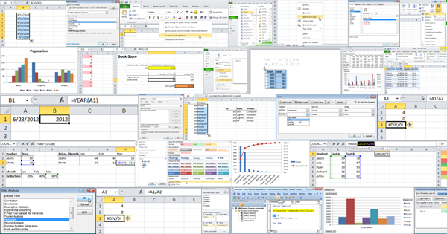
Un Excel complejo no es un algoritmo
Sino que una oportunidad para buenos consultores y organización a través de algoritmos!
Escuchar el siguiente Podcast: https://talkpython.fm/episodes/show/200/escaping-excel-hell-with-python-and-pandas

Slide 9

Why algorithms are called algorithms BBC Ideas = https://www.youtube.com/watch?v=oRkNaF0QvnI

Slide 10
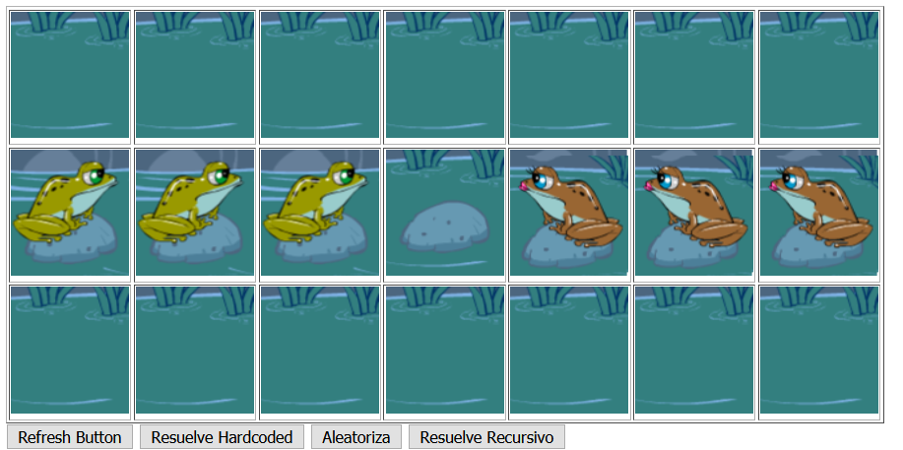
EJERCICIO: Jugar el juego de las RANAS:
http://mfalonso.pythonanywhere.com/ranas
Escribir los pasos para resolver el problema – los movimientos

Slide 11
Conclusión:
Un algoritmo es un conjunto de instrucciones o reglas definidas y no-ambiguas, ordenadas y finitas que permite, típicamente, solucionar un problema, realizar un cómputo, procesar datos y llevar a cabo otras tareas o actividades. Un algoritmo tiene un estado inicial y una entrada, sigue pasos sucesivos y llega a un estado final obtiendo una solución.

Slide 12



Ordenadores
¿Qué es un ordenador?
¿Qué se puede hacer con un ordenador?
Los ordenadores pueden realizar gran cantidad de tareas ya que son programables.

Slide 13



Programación
¿Qué es un programa?
Un programa es un conjunto de instrucciones que un ordenador sigue para poder realizar una tarea.
Flexibilidad.
Funcionalidad.

Slide 14
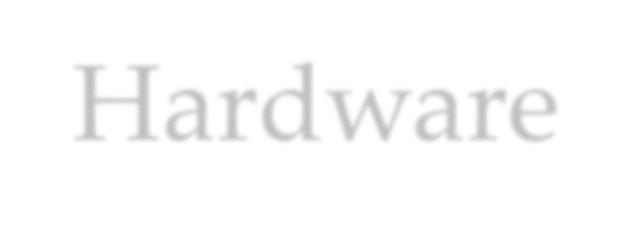

Hardware
El hardware son los componentes físicos con los que está construido un ordenador.
Principalmente está formado por:
CPU
Memoria principal
Dispositivos de almacenamiento secundario
Dispositivos de entrada
Dispositivos de salida

Slide 15
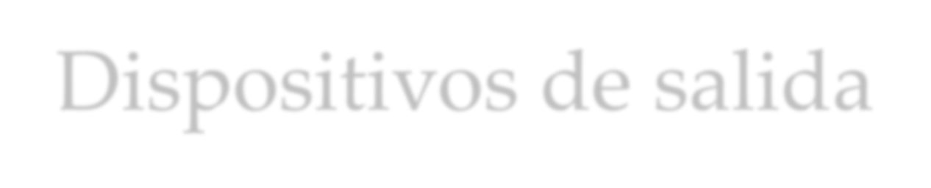

Dispositivos de salida
En inglés output devices.
Son los dispositivos que permiten al ordenador enviar información al mundo exterior.
Ej: monitor, impresora, altavoz, etc.

Slide 16
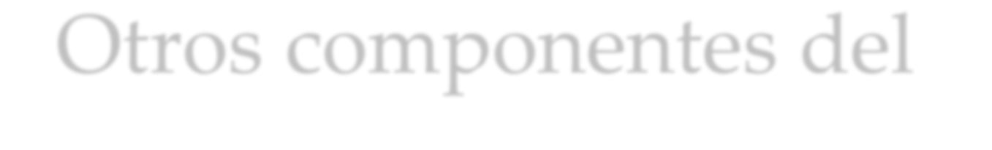
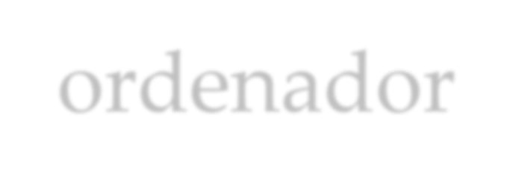
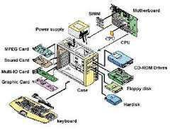
Otros componentes del
ordenador
Tarjeta gráfica
o Traduce información interna del procesador y memoria a imágenes, posiblemente realizando muchas operaciones
Tarjeta de sonido
Igual que la tarjeta gráfica, pero con sonido. Suelen ser mucho más simples que las gráficas
Tarjeta de red
Comunicación del ordenador con otros ordenadores

Slide 17
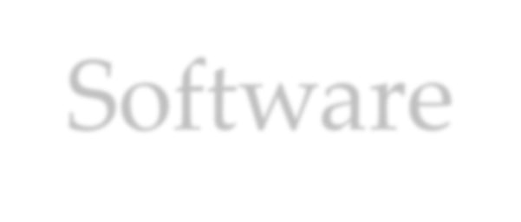


Software
Todo lo que hace el ordenador está bajo el control del software.
Un ordenador sin software no serviría para nada.
Se suele dividir en dos tipos:
Software de sistemas
SO, desarrollo, utilidades
Software de aplicaciones
EL resto de programas

Slide 18
CONTROL STRUCTURES
Descanso – volvemos a las 12:00

Slide 19
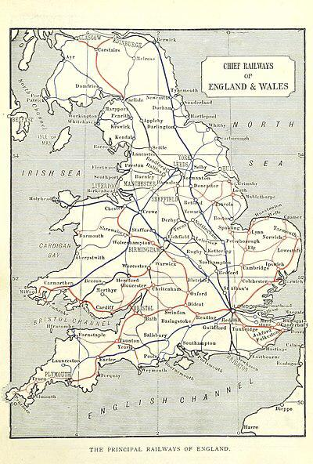
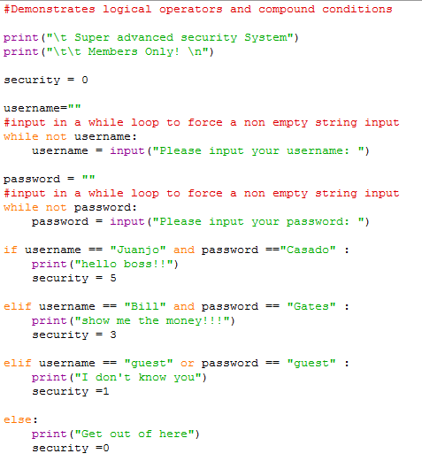

ONE SINGLE TRAIN (no parallelism) and while and if code

Slide 20
IF - Selective Control Structures.
IF-WITHOUT ELSE: If the Condition is True, the Action is executed, otherwise the algorithm continues with its execution.
GENERIC SINTAX IN PYTHON
if (condition):
action
PYTHON CODE EXAMPLE:
x = 5
if(x > 0):
print("Positive number")
R CODE EQUIVALENT:
x <- 5
if(x > 0){
print("Positive number")
}
Is condition True?
False
True
Action

Slide 21

R and Python https://www.youtube.com/watch?v=eRP_J2yLjSU

Slide 23

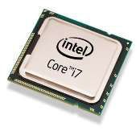

CPU
UCP en castellano. Unidad Central de Proceso
Es el dispositivo principal del ordenador.
Es el que ejecuta el programa.
Interpreta las instrucciones que forman los programas y procesa los datos
También llamado procesador o microprocesador.

Slide 24
Hardware
El hardware son los componentes físicos con los que está construido un ordenador.
Principalmente está formado por:
CPU
Memoria principal
Dispositivos de almacenamiento secundario
Dispositivos de entrada
Dispositivos de salida

Slide 25
Exercise – transform the following Flow Diagram into PYTHON code in SPYDER:
Check if the number is negative if it is print the number, otherwise do not print.
START
Read num
FALSE
Num < 0?
TRUE
Print Num
END

Slide 26
Exercise – transform the following Flow Diagram into PYTHON code in SPYDER:
Check if the number is negative if it is print the number, otherwise do not print.
START
PYTHON CODE SOLUTION:
numb = input("Please, enter a number: ")
numb = int(numb)
if (numb < 0):
print(numb)
R CODE SOLUTION EQUIVALENT:
numb <- readline(prompt="Please, enter a number: ")
numb <- as.integer(numb)
if (numb < 0) {
print(numb)
}
Read numb
FALSE
numb < 0?
TRUE
Print numb
END

Slide 27



Dispositivos de entrada
En inglés input devices.
Son los dispositivos que permiten al ordenador obtener información del mundo exterior.
Ej: teclado, ratón, USB, CD/DVD/BR, etc.

Slide 28
IF-ELSE - Selective Control Structures.
IF-ELSE: If the Condition is True, Action 1 is executed, otherwise the algorithm executes Action 2. Then the algorithm continues with its execution.
GENERIC SINTAX IN PYTHON
if (condition):
action1
else:
action2
PYTHON CODE EXAMPLE:
x = -5
if(x >= 0):
print("Non-negative number")
else:
print("Negative number")
R CODE EXAMPLE EQUIVALENT:
x <- -5
if(x >= 0){
print("Non-negative number")
} else {
print("Negative number")
}
Is condition True?
False
True
ACTION 1
ACTION 2

Slide 29
IF-ELSE-IF - Selective Control Structures.
IF – ELSE – IF: If the condition 1 is TRUE, Action 1 is executed, otherwise the algorithm evaluates if condition 2, if TRUE, action 2 is executed, otherwise action 3 is executed.
GENERIC SINTAX IN PYTHON
if (condition 1):
action 1
elif (condition 2):
action 2
else:
action 3
PYTHON CODE EXAMPLE:
x = -5
if(x > 0):
print("Positive number")
elif (x < 0):
print("Negative number")
else:
print("Zero")
R CODE EXAMPLE EQUIVALENT:
x <- -5
if(x > 0){
print("Positive number")
} else if (x < 0) {
print("Negative number")
} else {
print("Zero")
}
Cond. 1 TRUE?
FALSE
Cond. 2 TRUE?
FALSE
TRUE
Action 1
TRUE
Action 2
Action 3
END

Slide 30
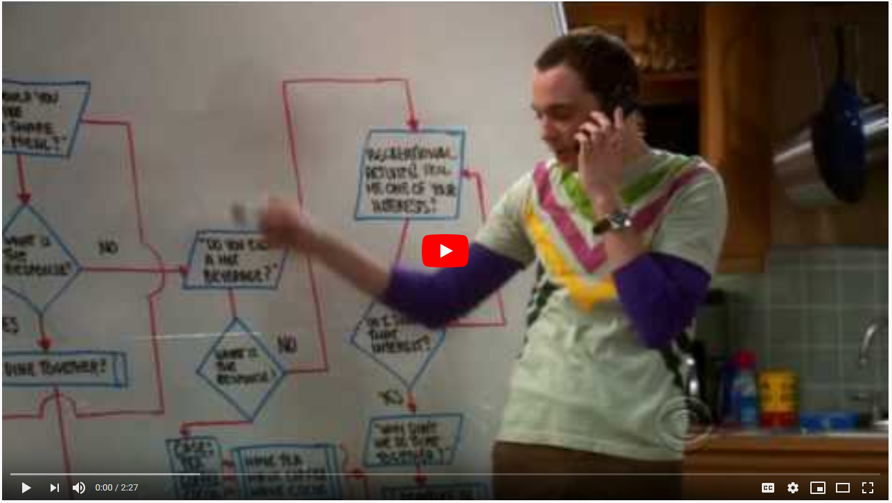
The Big Bang Theory - The Friendship Algorithm https://www.youtube.com/watch?v=k0xgjUhEG3U

Slide 31
WHILE LOOP - Repetitive Control Structures.
While: The Condition is evaluated. If True, the Action is executed and the condition is evaluated again. As soon as the Condition is False, the loop is exited and the algorithm continues to run. When the Condition is evaluated, at the beginning, before entering the loop, if the condition is False, it will never enter the loop. Therefore this type of loop is obligatorily used, in the event that, there is a possibility that the loop can be executed 0 times.
GENERIC SINTAX IN PYTHON
while (condition):
action
else:
final_action
PYTHON CODE EXAMPLE:
i = 5
while(i > 0):
print(".")
i = i – 1
R CODE EXAMPLE EQUIVALENT:
i <- 5
while(i > 0){
print(".")
i <- i - 1
}
Is condition True?
False
True
Action
END

Slide 32
Exercise 2 – transform the following Flow Diagram into PYTHON code: Show the product of positive integers entered by keyboard until the entry of a negative number.
START
P = 1
Read num
FALSE
Num >= 0?
TRUE
Print P
P = P * num
Read num
END

Slide 33
Solution
PYTHON CODE SOLUTION:
P = 1
numb = input("Please, enter a number: ")
numb = int(numb)
while numb>=0:
P = P * numb
numb = int(input("Please, enter a number: "))
numb = int(numb)
print(P)
R CODE SOLUTION EQUIVALENT:
P <- 1
numb <- readline(prompt="Please, enter a number: ")
numb <- as.integer(numb)
while (numb>=0) {
P <- P * numb
numb <- readline(prompt="Please, enter a number: ")
numb <- as.integer(numb)
}
print(P)
START
P = 1
Read num
FALSE
Num >= 0?
TRUE
Print P
P = P * num
Read num
END

Slide 34
REPEAT LOOP - Repetitive Control Structures.
Do – While (or repeat while): In the first instance, the action is executed. Subsequently, the Condition is evaluated. If True, the Action is executed again. If it is False, the execution of the algorithm continues. The loop repeats as long as the condition is True. The Condition is always evaluated at the end of the loop, if it is True the Action is executed again, if it is False it exits the loop. Since the Condition is evaluated at the end, even if the first time is False, the loop (the Action) will have been executed at least once.
GENERIC SINTAX IN R
repeat {
action
stops if reaches a condition
}
R CODE EXAMPLE:
i <- 5
repeat {
i <- i - 1
print(".")
if (i == 0) { break }
}
PYTHON DOES NOT HAVE IT!
EMULATING IT IN PYTHON
i = 1
while True:
print(i)
i = i + 1
if(i > 5):
break
Action
Condition reached?
TRUE
FALSE
END

Slide 35
FOR LOOP - Repetitive Control Structures.
From - To: Used when the exact number of times to iterate is known. For this, the loop will have an associated variable "index", to which an initial value is assigned and it is determined what its final value will be and it will also increase (or decrease) in each loop iteration by a constant value .
GENERIC SINTAX IN PYTHON
for val in sequence:
statement
PYTHON CODE EXAMPLE:
x = [2,5,3,9,8,11,6]
count = 0
for val in x: #In python () are not allowed
if(val % 2 == 0):
count = count+1
#a blank line is recommended at the end of loops
print(count)
R CODE EXAMPLE EQUIVALENT:
# Below is an example to count the number of even numbers in a vector.
x <- c(2,5,3,9,8,11,6)
count <- 0
for (val in x) {
if(val %% 2 == 0) {
count = count+1
}
}
print(count)
Repeat N times. 1
2
3…
N
FINISHED
Action
END

Slide 36

EJERCICIO
Escribir un programa que encuentre todos los números que son divisibles por 7 pero que no son múltiplos de 5, entre 2000 y 3200 (ambos incluidos).
Sugerencia: para bucle for y la función range()

Slide 37
SWITCH - Selective Control Structures.
Switch case (multiple alternative): A condition or expression that can take “n” values is evaluated. According to the value that the expression has at each moment, the actions corresponding to the value are executed. The value with which the expression is compared will depend on the languages, on whatever that value is. In general, that value can be a constant value, a range of values, or even another condition.
GENERIC SINTAX IN R
switch(expression, case1, case2, case3....)
R CODE EXAMPLE:
val1 <- 6
val2 <- 7
val3 <- "s"
result <- switch(
val3,
"a"= cat("Addition =", val1 + val2),
"d"= cat("Subtraction =", val1 - val2),
"r"= cat("Division = ", val1 / val2),
"s"= cat("Multiplication =", val1 * val2),
"m"= cat("Modulus =", val1 %% val2),
"p"= cat("Power =", val1 ^ val2)
)
Expression or condition
Value 1:
Action 1
Value 2:
Action 2
…
Value n:
Action “n”
PYTHON DOES NOT HAVE IT! DO IT WITH elif

Slide 38
How do you consider when something should be in the standard library?
A) Any brand new piece that has been developed and finished.
B) A new API that joins with the current hottest application at the moment.
C) Anything that is being actively developed.
D) Something that is useful for multiple range (a wide variety) of applications.
Right answer at 24:32.
https://talkpython.fm/episodes/show/100/python-past-present-and-future-with-guido-van-rossum

Slide 39
How do you consider when something should be in the standard library?
A) Any brand new piece that has been developed and finished.
B) A new API that joins with the current hottest application at the moment.
C) Anything that is being actively developed.
D) Something that is useful for multiple range (a wide variety) of applications.
Right answer: d) Something that is useful for multiple range (a wide variety) of applications. 24:32.
https://talkpython.fm/episodes/show/100/python-past-present-and-future-with-guido-van-rossum

Slide 40
SWITCH - Selective Control Structures.
Switch case (multiple alternative): A condition or expression that can take “n” values is evaluated. According to the value that the expression has at each moment, the actions corresponding to the value are executed. The value with which the expression is compared will depend on the languages, on whatever that value is. In general, that value can be a constant value, a range of values, or even another condition.
GENERIC SINTAX IN R
switch(expression, case1, case2, case3....)
R CODE EXAMPLE:
val1 <- 6
val2 <- 7
val3 <- "s"
result <- switch(
val3,
"a"= cat("Addition =", val1 + val2),
"d"= cat("Subtraction =", val1 - val2),
"r"= cat("Division = ", val1 / val2),
"s"= cat("Multiplication =", val1 * val2),
"m"= cat("Modulus =", val1 %% val2),
"p"= cat("Power =", val1 ^ val2)
)
Expression or condition
Value 1:
Action 1
Value 2:
Action 2
…
Value n:
Action “n”

Slide 41
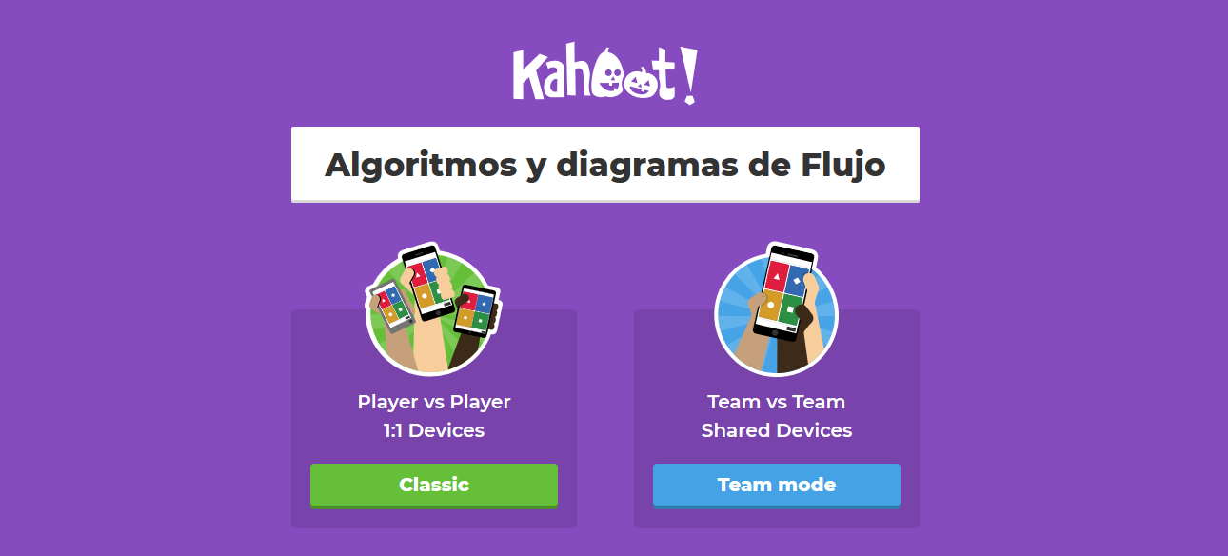

Slide 42

PRE-WORK (hasta próxima clase)
https://codecombat.com/students?_cc=FalseSellOpen

Slide 43
EJERCICIO INDIVIDUAL
http://mfalonso.pythonanywhere.com/ipe

Slide 44
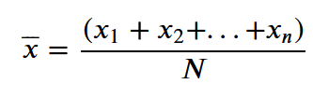
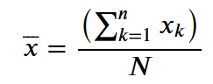
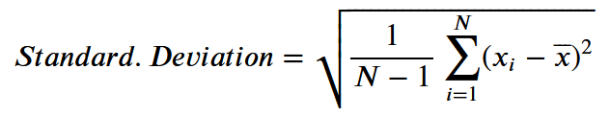
EJERCICIOS – 11:40
Exercises:
Using women = [43.5, 54.3,68.9,70,2] and only for loops calculate the:
Sum
Solution:
sum = 0
for h in women:
sum = sum + h
print(sum)
Min
Max
Average
Standard Deviation

